Slide 1
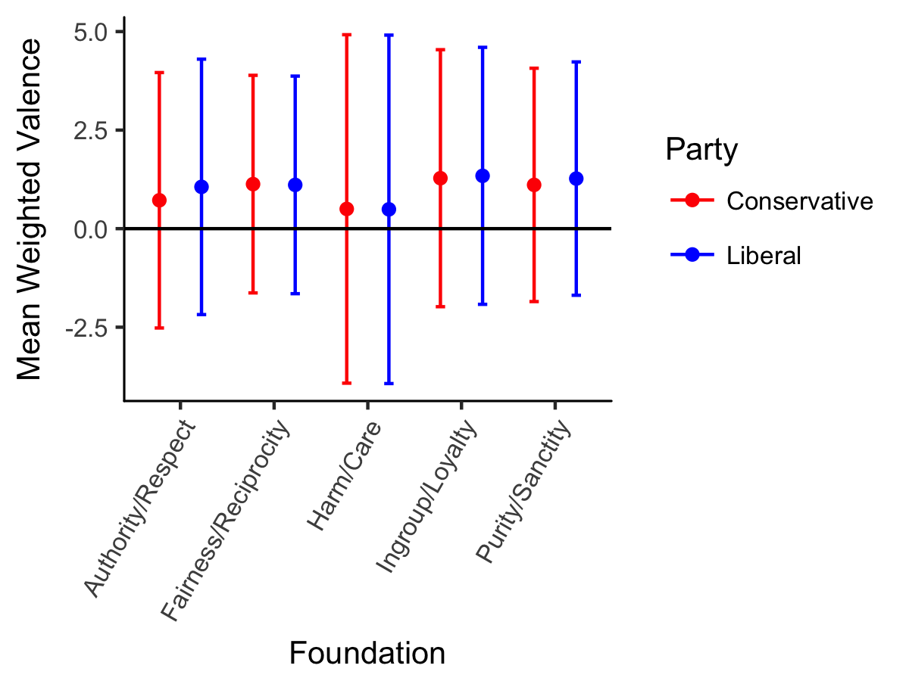
Moral Foundations of U.S. Political News Organizations
William E. Padfield and Erin M. Buchanan
Missouri State University
Abstract
The media ecosystem has grown, and political opinions have diverged such that there are competing conceptions of objective truth. Commentators often point to political biases in news coverage as a catalyst for this political divide. The Moral Foundations Dictionary (MFD) facilitates identification of ideological leanings in text through frequency of the occurrence of certain words. Through web scraping, the researchers extracted articles from popular news sources’ websites, calculated MFD word frequencies, and identified words’ respective valences. This process attempts to uncover news outlets’ positive or negative endorsements of certain moral dimensions concomitant with a particular ideology. The researchers gathered political articles from four sources. They were unable to reveal significant differences in moral or political endorsements, but they solidified the method for future research.
Results
Graph – Mean Weighted Valence by Foundation
Descriptive Statistics – Moral Foundations
Foundation | M_{C} | SD_{C} | M_{L} | SD_{L}
Harm/Care | 0.50 | 2.21 | 0.49 | 2.21
Fairness/Reciprocity | 1.13 | 1.38 | 1.11 | 1.38
Ingroup/Loyalty | 1.28 | 1.63 | 1.34 | 1.63
Authority/Respect | 0.72 | 1.62 | 1.06 | 1.62
Purity/Sanctity | 1.11 | 1.48 | 1.27 | 1.48
Note. For mean and standard deviation values, ‘C’ and ‘L’ refer to ‘conservative’ and ‘liberal’ respectively. Given the values obtained, it became clear usage of MFD words was quite similar across the foundations regardless of political lean.
Multilevel Model – Moral Foundations
Method
Sources
Political news articles from four U.S. sources - two preferred by liberals and two by conservatives (Mitchell, et al., 2014). The sources were The New York Times, NPR, Fox News, and Breitbart.
Procedure
Body text of articles was scraped using the rvest library in R.
Using the tm and ngram packages, text was stemmed and processed to remove blanks, duplicates, punctuation, and capitalization.
The same procedure was applied to the words in the Warriner, et al. (2013) dataset of affective ratings for 13,915 English lemmas.
Problem: Graham, et al.’s (2009) MFD does not account for valence – it assumes any word occurrence is positive endorsement. Also, it cannot be as specific as the Moral Foundations Questionnaire (MFQ; Graham, et. al., 2011). See example for harm/care foundation:
MFQ item: It can never be right to kill another human being.
Participant rates agreement on six-point scale.
MFD words: benefit, cruel, guard, kill; valence is intuitive, but unaccounted for by MFD analyses. Other foundations (such as purity/sanctity) are even less clear-cut.
Solution: incorporate valence (pleasantness) ratings from Warriner et al. (2013).
Article words were matched up with MFD counterparts and percent occurrence, which was multiplied by z-scored valence creating a weighted sum for each moral foundation.
Analysis
A multilevel model controlling for correlated error of political lean and source was used to analyze the data.
Independent variable was political lean with news source as a random intercept predicting weighted percentage of each foundation.
Overall valence, types (unique words), tokens (total words), and readability for each source were calculated as well.
Foundation | t | p | d
Harm/Care | -0.21 | .850 | 0.01
Fairness/Reciprocity | -0.42 | .715 | 0.02
Ingroup/Loyalty | 0.30 | .789 | -0.04
Authority/Respect | 3.17 | .087 | -0.20
Purity/Sanctity | 2.37 | .141 | -0.09
Note. This graph is a visualization of the mean weighted valence scores and standard deviations for the five moral foundations. Each foundation appeared to receive slightly positively-valenced endorsements across political lean. None, however, seem to be appreciably different from one another despite the political lean of the sources.
Note. The MLM did not indicate the presence of any significant or practical effect of political lean for any of the moral foundations. The strongest effect was observed for authority/respect, but in the opposite direction from what was expected. The sign of the weighted mean score indicates directionality of endorsement for that moral foundation.
Descriptive Statistics - Sources
Discussion
The researchers found little compelling evidence of an effect of partisan lean on MFD endorsement. Upon speculation, the researchers identified one possible reason for why the results failed to reveal such an effect: the selection of the amorphous topic of “political news” may have led to the scraping of large numbers of articles with little to no moral-centric content. Rather, many articles have contained, for example, simple reporting on procedural matters that would leave little room for the use of words from the Moral Foundations Dictionary.
Given the exploratory nature of this study, the researchers were able to fine-tune the methodology for use in future research. To this end, current research is underway that focuses on specific topics with moral relevance, including Brett Kavanaugh’s Supreme Court nomination and the most recent government shutdown. Articles are being scraped from a wider range of sources as well.
Source | Mean Valence (SD) | Mean Tokens (SD) | Mean Types (SD) | Mean Readability (SD)
The New York Times | 0.30 (0.31) | 1114.73 (511.86) | 454.27 (154.58) | 16.32 (3.29)
NPR | 0.28 (0.23) | 435.94 (642.63) | 191.96 (192.29) | 13.80 (3.92)
Fox News | 0.29 (0.17) | 590.02 (528.60) | 283.57 (189.00) | 16.92 (7.16)
Breitbart | 0.29 (0.18) | 502.45 (347.90) | 243.36 (120.76) | 18.42 (8.01)
Note. Valence is z-scored. Readability statistics were calculated using the Flesch-Kincaid Grade Level readability formula.
Contact: William E. Padfield (Padfield94@live.missouristate.edu) or Dr. Erin M. Buchanan (erinbuchanan@missouristate.edu)

